Slide 1
GIN

Slide 2
GIN
Gin first reached England in the 16th century through the English soldiers.
Geniever Ginever Gin
Gin reached the ports of Bristol, Plymouth, Portsmouth and then to other big cities.
By the first decade of 17th century, it was challenging the sales of Rum & Brandy.

Slide 3
GIN
Gin consumption
1690 5,00,000 gallons
1727 5,000,000 gallons
1733 11,000,000 gallons
In 1736 parliament passed first of the Gin Acts, to reduce the number of gin shops and to make it expensive for the working class.

Slide 4
1736 Gin act
  Forbade selling of gin in quantities under 2 gallons.
  Introduced 50 pound license to sell spirits.
  Put a tax of 1 pound per gallon of gin.
The act was repelled in 1743, by the production had soared to 20,000,000 gallons.

Slide 5
In 1751 parliament introduced another Gin Act in which reasonable taxes were levied and production of quality gin was encouraged.
To everyone in the 1850’s Gin still meant Holland, a pungent sweet distillation.
Introduction of the Dry Gin.

Slide 6
PRODUCTION OF GIN
The first step is to produce a neutral spirit, usually done in a continuous still, either from maize or molasses.
The next stage is the infusion of the botanicals into the neutral spirit.

Slide 7
PRODUCTION OF GIN
All gins contain junipers. The ingredients could be:
  Coriander
  Angelica
  Cassia bark
  Orrice root
  Calmus root
  Orange or Lemon peel

Slide 8
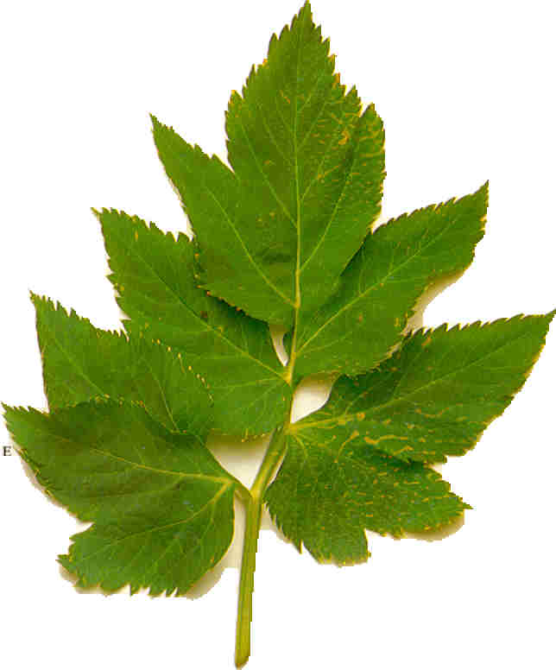
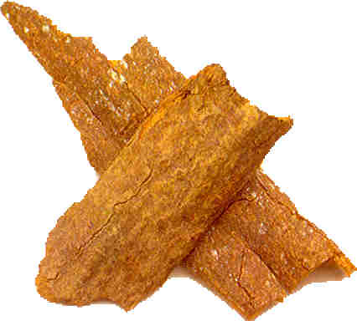
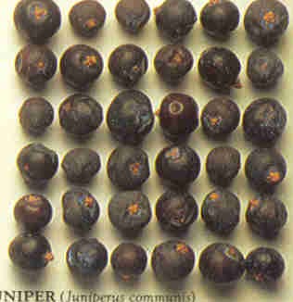
Angelica
Cassia Bark
Juniper Berries

Slide 9
METHOD OF FLAVOURING
    Head Mix
    The traditional system wherein the botanicals is distilled with the spirit by enclosing the botanicals in a head ( mesh ) in the neck of the still. Eg Beefeater’s

Slide 10
METHOD OF FLAVOURING
    Cold Mix
    The botanicals ( 2 kg for 100 liters of spirit) is soaked in the spirit, and then distilled in a pot still to give a strong flavour. Later diluted with unflavoured neutral spirit until the correct proportions of alcohol & ingredients is achieved.

Slide 11
AGING
Gin , being a rectified spirit does not require
to be aged / matured in wood either legally or
technically.

Slide 12
SOME BRANDS
Gordon’s Bols
Gilbey’s Locomotief
Beefeaters Bokma
Tanqueray Geens
Nicholson Claeryn
Booth’s Citroen
White Satin Hoppe
House of Lords Bombay Sapphire
Boodles

Slide 13
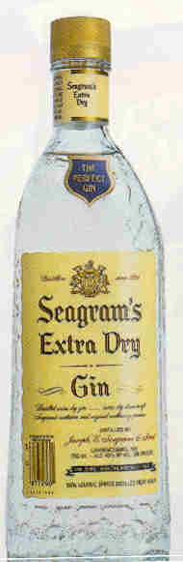
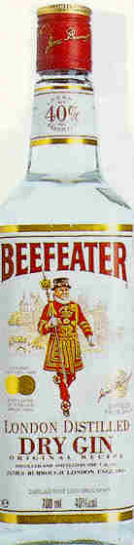
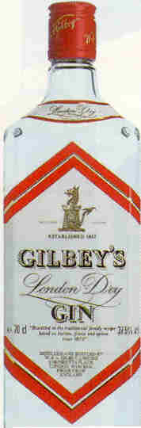
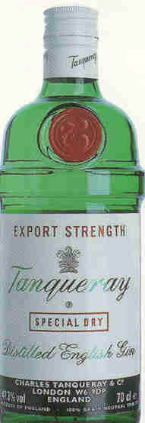
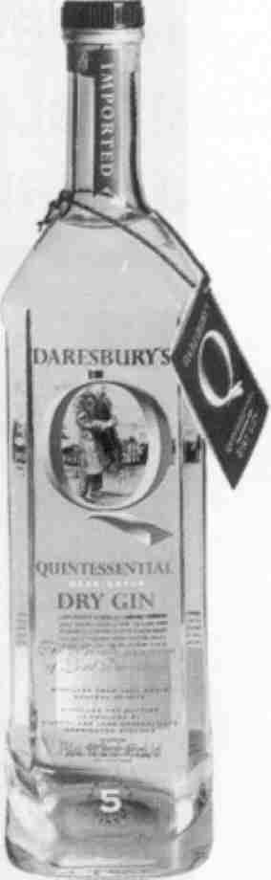

Slide 14
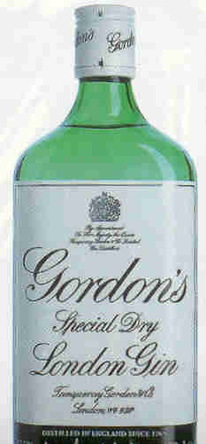
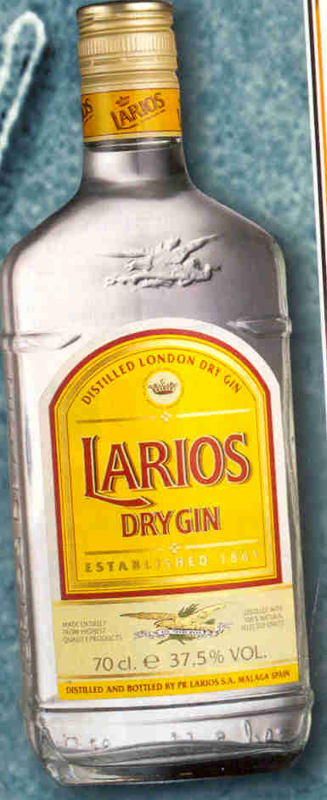
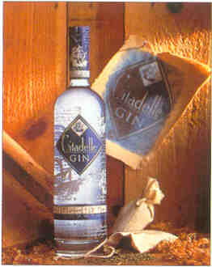

Slide 15
PLYMOUTH GIN
Historically associated with the Royal Navy
Has an advantage for the distillers - the softness of the water.
The first major distillery was operated by the Coates family in 1793, which operates even today.

Slide 16
PLYMOUTH GIN
Unlike London Gin, the Plymouth gin is diluted using water direct from the source, which adds to the smoothness & softness of the gin.

Slide 17
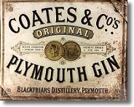

Slide 18
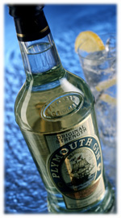

Slide 19
FLAVOURED GIN
Pimms No 1 - Gin, compounded with herbs & essences. Recipe largely a secret.
Old Tom - Gin sweetened with sugar syrup ( between 2 - 6 %)
Sloe Gin - flavoured with Sloe berries.
Other flavourings
Lemon
Orange
Blackcurrants.

